Slide 1
User Research Study 3b Homepage Wireframes v2
Prepared by the Digital Service at Veterans Affairs (DSVA)
Prepared for and presented to the VA Web Brand Consolidation Working Group
April 2018

Slide 2
Outline
This study further refined our understanding of Veteran’s preferences for the homepage.
1. Study Objectives
2. Research Method
3. Findings
4. Recommendations

Slide 3
1. Study Objectives

Slide 4
Our goal was to gather feedback on two homepage designs
Study objectives
Which of our revised design concepts works best for Veterans?
What are the pros/cons of each?
What do Veterans think of the revised top task approach?
What do they think of the look and feel?
What do they think about the two CTA button layout options?

Slide 5
2. Research Method

Slide 6
We spoke with Veterans in person to learn more about what works for them.
Research Method
Visited Ft Belvoir CBOC (part of DC MC)
Spoke with 9 men Veterans of varying ages and races
Showed them two revised homepage designs (paper wireframes)
Asked structured questions to gather feedback (similar questions to study 3a)

Slide 7
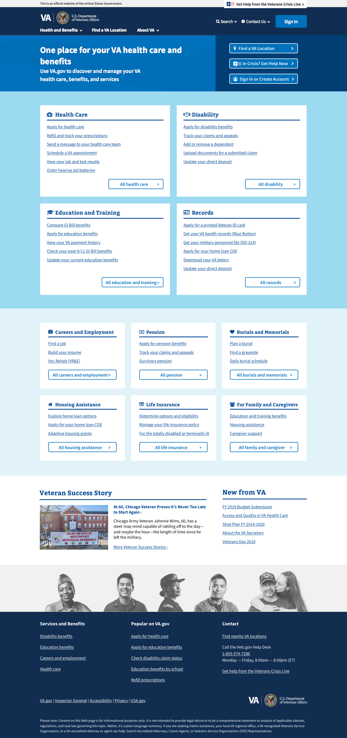
Research Method
Header
Zone 1 – Welcome, location, login
Zone 2 – Top tasks or benefits
Zone 3 – All benefits
Zone 4 – Good news stories, inside VA
Footer

Slide 8
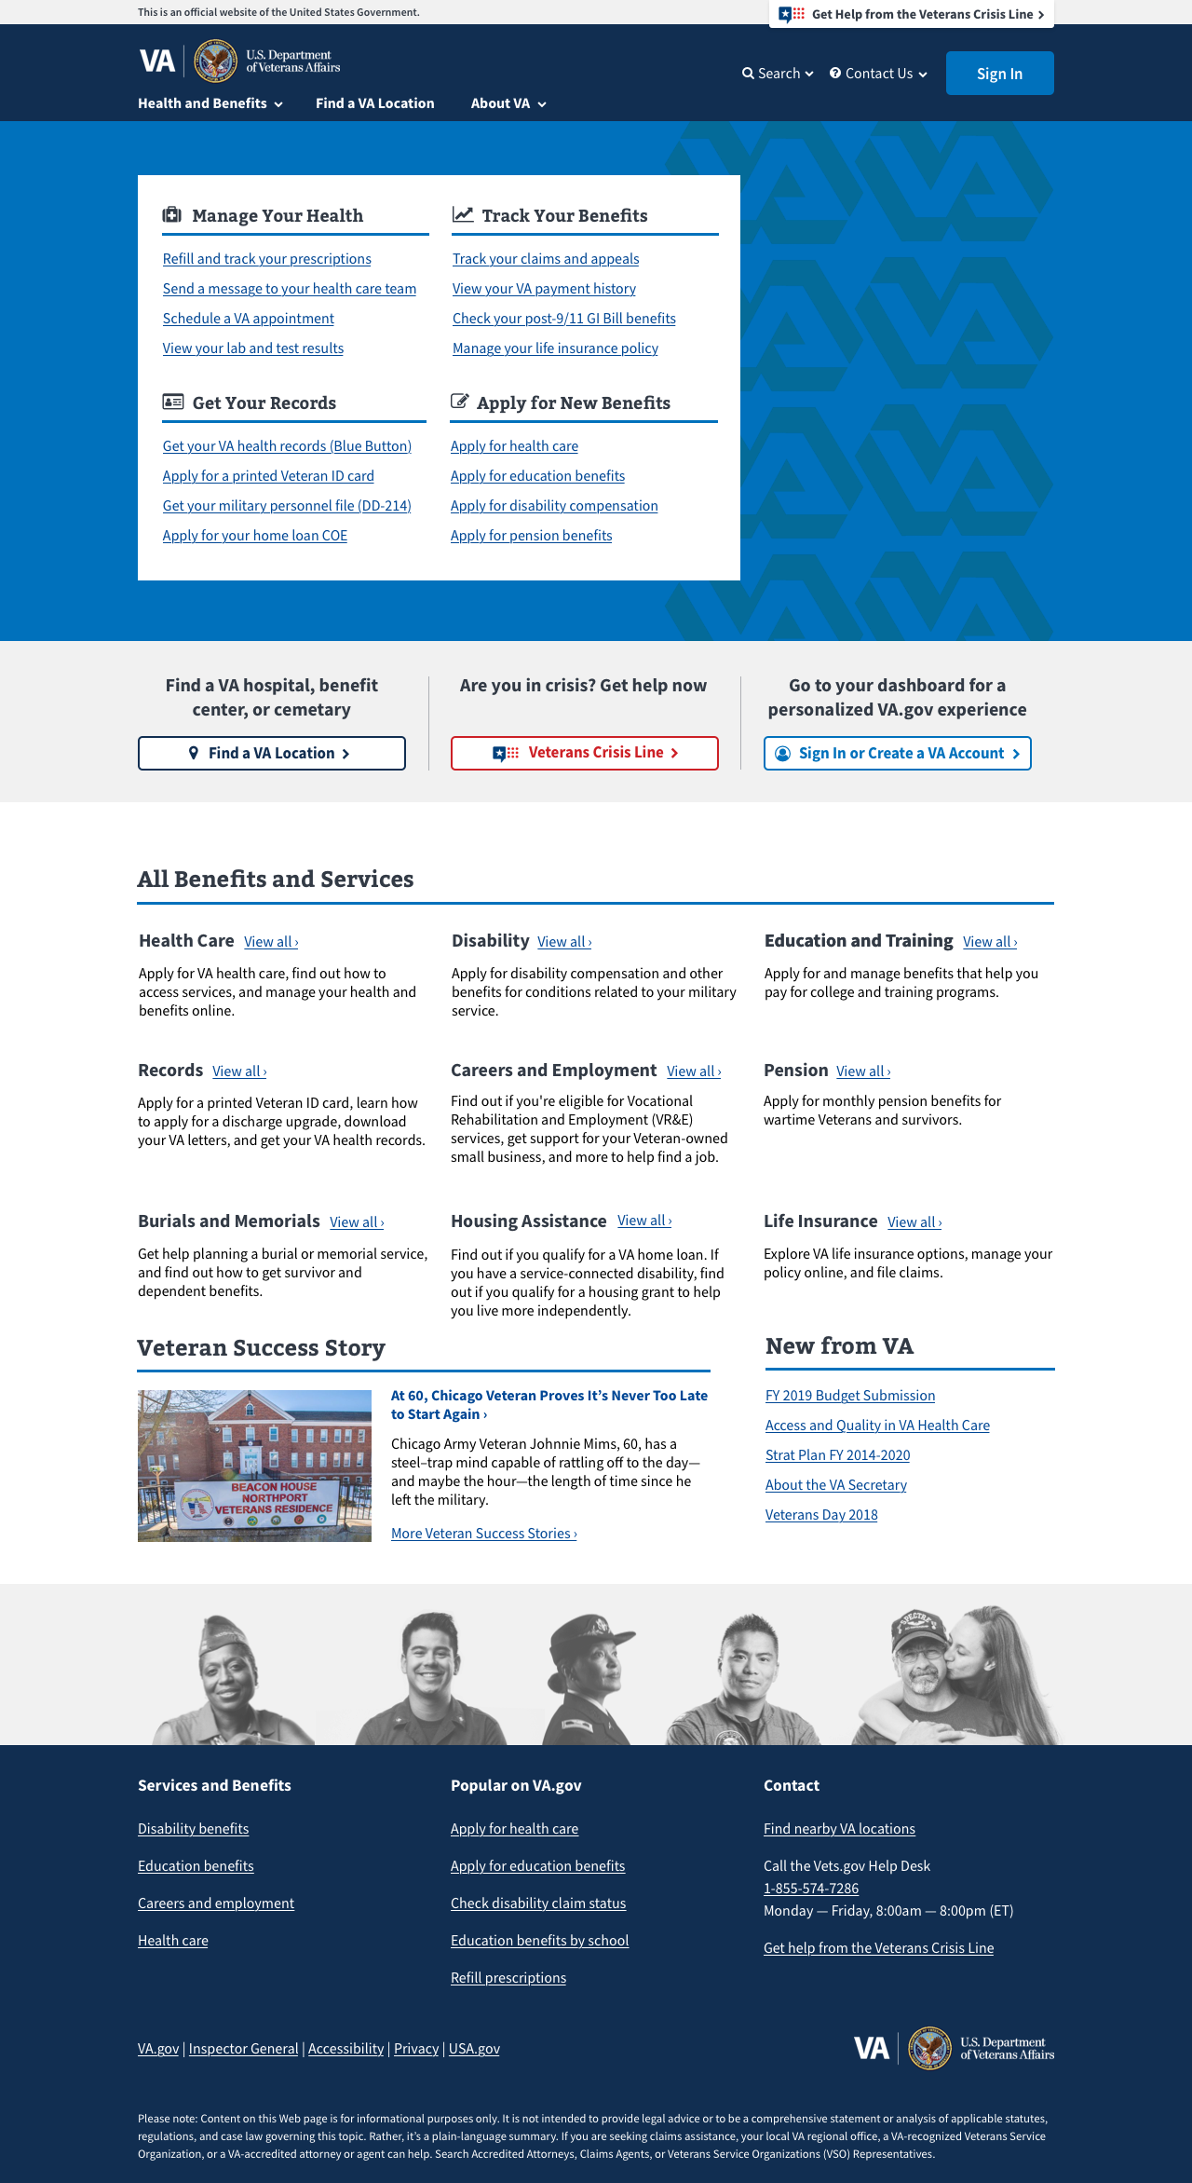
Research Method
Header
Zone 1 – Welcome, location, login
Zone 2 – Top tasks or benefits
Zone 3 – All benefits
Zone 4 – Good news stories, inside VA
Footer

Slide 9
Top Tasks Homepage v2
Research Method
Zone 1 focused on the top tasks organized under manage health, track benefits, get records, apply for benefits
Zone 2 had the location, crisis line, and sign-in
Zone 3 listed each benefit category with a simple description and CTA

Slide 10
Benefit Category Homepage v2
Research method
Zone 1 had the location, crisis line, and sign-in
Zone 2 listed the top 4 benefit categories with top tasks
Zone 3 showed the remaining benefits with lists of top tasks for each

Slide 11
3. Findings

Slide 12
Veterans prefer the benefit category design with some modifications
findings
The default mental model for Veterans is benefit category first then task
Veterans had difficulty finding information using the headings in the top tasks design
CTA buttons in the top task design (color and placement) worked best
The layout of the top benefit categories worked well
Both designs are boring and need more color
Veterans want the page to be simple and not cluttered
Veterans want large, clear, text and icons
One-click access and “above the fold” priority are important to Veterans

Slide 13
In their own words…
Findings
"Our brains are trained to organize by type of benefit. The headings for top tasks are different.” – P16
"Your eyes go right to what you're looking for.” – P15
"As long as you can click on one thing and go straight to the page” – P11
"It's bland, but it's functional. It has all the options you can choose from...and all the things you need.” – P14
“The font is too small” – P11
"It's about the same, but with a little bit more options.” – P13

Slide 14
4. Recommendations

Slide 15
What Now?
Recommendations
The benefit category is the default mental model for organizing information, but top tasks are why users come to va.gov.

Slide 16
Next steps
Recommendations
Create a final design concept that includes the best elements from both designs.
New design will feature
Zone 1 – Shows the four benefit categories in boxes and the CTA ribbon from top tasks design
Zone 2 – All 10 benefit categories in the boxes from benefit category design
Zone 3 – Good news stories and More from VA
Conduct user testing on a clickable prototype of this design

Slide 17
Thank you!
Contact Jeff Barnes with questions:
jeffrey.barnes4@va.gov

Slide 18
Limitations of Study
Appendix
All participants were men
All participants were currently enrolled in VA Medical care, but not necessarily MHV users
Participants were limited to one medical center in DC area
Paper wireframe format varies significantly from interactive, especially related to navigation priority and fold placement

Slide 19
Did we answer our research questions?
Appendix
Which of our revised design concepts works best for Veterans? Benefit category.
What are the pros/cons of each? Listed above.
What do Veterans think of the revised top task approach? They did not like the headers and still preferred benefit category.
What do they think of the look and feel? Still too boring, needs color.
What do they think about the two CTA button layout options? They preferred the Top Task version.

